Slide 1
EXAMINATION REFORMS GENERAL SCIENCE & BIOLOGICAL SCIENC

Slide 2
Assessment Procedures
Two Types
Formation Assessment
4 Times in a Year
(July, September, December and February)
Summative Assessment
3 Times in a Year
(September, January and April)

Slide 3
Formative Assessment
Diagnostic and Remedial
Oral and Written Forms
Makes Provision for Effective Feedback
Recognize needs of students , Understand how to improve
Encourage Students Performance and judge their work.
Builds on Student prior knowledge and experience in designing what is start.
Assessment for Learning and Assessment as Learning

Slide 4
Formative Assessment - Tools
Sl. No. | Name of Tool | Marks
1 | Lab Record | 10
2 | Written Works | 10
3 | Project Work | 10
4 | Slip Tests | 10
 | TOTAL | 50

Slide 5
How to Assess
Lab Record
List out Activities
Groups Formation
Activity Allotment
Conducting Activity
Record Writing
Presentation and Discussion

Slide 6
How to Assess
Marks Allotment
Performing Experiment
Record Writing
Presentation and Discussion
Total 10 Marks

Slide 7
Contd…
2. Written Works
Class Work, Home Work Notebooks maintenance.
Textual Exercises
Portfolios (Wall Magazine write-ups)

Slide 8
How to Assess
Marks Allotment
Own Answers
Proper Maintaining of Note Books
Other Write Ups for wall magazine etc. (Portfolio)
Total 10 Marks

Slide 9
3. Project Work
List out Projects
Groups Formation
Project Allotment
Conducting Project
Project Report Writing
Presentation and Discussion
Note: 3rd F.A. Project should be socially related Project.
Project Presentation Day - Every last Thursday of the Formative Period

Slide 10
How to Assess
Marks Allotment
Selection and Conduct of Project
Project Report
Presentation and Discussion
Total 10 Marks

Slide 11
4. Slip Test
Marks - 20
Duration - 45
Syllabus - Completed Areas
Questions - Selected Academic Standards
- Essay / Short Answer / M.C.Q.
Frequency - 1 @ F.A.
Note: No Specific Time Table.

Slide 12
Contd…
Post Slip Test Activities
Question wise Analysis
Identify Reasons for lagging behind
Re-Teaching Activities

Slide 13
SUMMATIVE ASSESSMENT
Paper-Pen Test
All Academic Standards should be tested
Question Paper based on Academic Standards and its weightage.
3 times in a Year
80 Marks Test for class VI and VIII
40 Marks Test for class VIII, IX and X
20 Marks weightage will be calculated from 4 Formatives and 3 Summatives.

Slide 14
Nature of Questions
Qualitative
Open Ended
Analytical
Drawing Conclusions
Giving Reasons
Evaluating and Interpreting
Creative
Critical Thinking
Problem Solving
Communicating Skills

Slide 15
Academic Standard wise Weightage Table
Class VI - X
Sl. No. | Academic Standard | Weightage
1 | Conceptual Understanding | 40%
2 | Asking Questions, Making Hypothesis | 10%
3 | Experiments, Field Investigations | 15%
4 | Information Skills | 15%
5 | Communication through Drawing | 10%
6 | Appreciation, Values, Daily life Applications | 10%

Slide 16
Types of Questions
Sl. No. | Types of Questions
1 | Essay
2 | Short Answer
3 | Very Short Answer
4 | Objective (Multiple Choice)

Slide 17
Marks Allotment Class : VIII - X
Sl. No. | Type of Question | No. of Questions | Each Question Carries | Total Marks | Percentage
1 | Essay | 4 | 4 | 16 | 40%
2 | Short Answer | 5 | 2 | 10 | 25%
3 | Very Short Answer | 4 | 1 | 4 | 10%
4 | M.C.Q. | 20 | ½ | 10 | 25%
 | TOTAL | 33 |  | 40 | 100%

Slide 18
Marks Allotment Class : VI - VII
Sl. No. | Type of Question | No. of Questions | Each Question Carries | Total Marks | Percentage
1 | Essay | 4 | 8 | 32 | 40%
2 | Short Answer | 5 | 4 | 20 | 25%
3 | Very Short Answer | 4 | 2 | 8 | 10%
4 | M.C.Q. | 20 | 1 | 20 | 25%
 | TOTAL | 33 |  | 80 | 100%

Slide 19
Blue Print
Academic Standard | Essay | Short Answer | Very Short Answer | MCQ | Total Marks
Conceptual Understanding | 2(8) | 1(2) | 1(1) | 10(5) | 16
Asking Questions | - | 1(2) | 1(1) | 2(1) | 4
Experiments | 1(4) | - | 1(1) | 2(1) | 6
Information Skills | - | 2(4) | - | 4(2) | 6
Drawing | 1(4) | - | - | - | 4
Values, Daily life | - | 1(2) | 1(1) | 2(1) | 4
TOTAL | 4(16) | 5(10) | 4(4) | 20(10) | 40

Slide 20
Nature of Questions
Essay Type:
From all Academic Standard except asking questions and making hypothesis.
Provide opportunity to the student to express his opinions, understanding about the concept in a paragraph form.
Do not ask discreet questions
Do not ask only on Conceptual Understanding

Slide 21
Contd…
Essay type Questions on Experimental Skills
On process
On required material and arrangement of apparatus
On hypothesis and the process to prove the selected hypothesis.
On result, tabulation, improvisation of the experiment

Slide 22
Contd…
Essay type Questions on Communication through Drawing
Do not ask mere drawing and labeling
Drawing along with some explanation
Give information, key words and ask them to draw its picture.
Give picture and ask them to write details

Slide 23
Contd…
Essay type Questions on Information Skills
Do not ask questions on Project Works
Give information and ask them to analyze data (data analysis)
Preparation of tabular form to collect data.
Data presentation- in the form of table , bar graph, pie graph, tree diagram etc.

Slide 24
Modal Questions
Essay Type
What do you understand by food web? Describe you own food web with the help of a diagrammatic representation.
Road side plant cannot grow properly, find your own reasons and explain your argument.

Slide 25
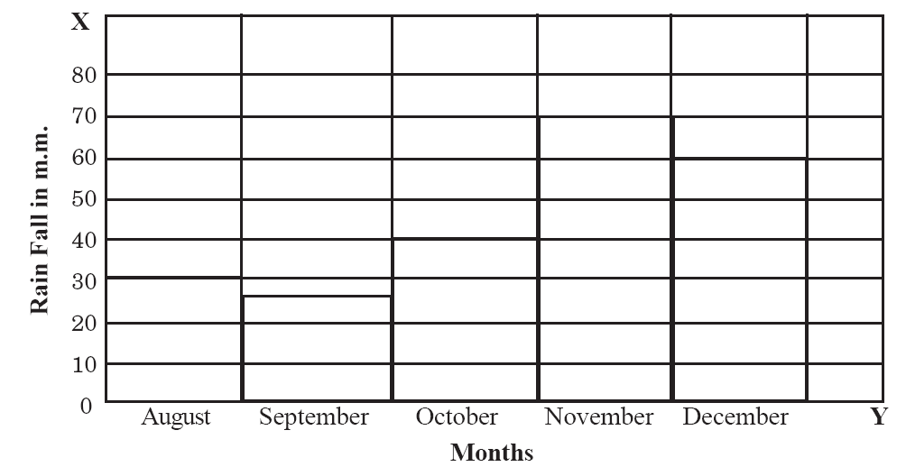
Modal Questions
Information Skills
Observe the graph showing rainfall (in mm) of a place from August to December. Write down the observations from it?

Slide 26
Read the following passage. Convert it into a tabular form.
Soil is make up of distinct horizontal layers called Horizons. They are divided into O, A, E, B, C and R horizons. O - horizon made of mostly of humus, Plant roots can grow in A - horizon. Water drips through E - horizon. B - horizon is also called subsoil. C - horizon consists of slightly broken up bedrock where as R - horizon have un-weathered Rock.

Slide 27
MCQ.
Match the following
a) Nucleus ( ) 1. Virchow
b) Cell ( ) 2. Hook
c) New Cells ( ) 3. Robert Brown
A) a-1, b-2, c-3 B) a-2, b-3, c-1 C) a-3, b-2, c-1 D) a-3, b-1, c-2

Slide 28
MCQ.
You came to know that CO₂, Methane, Co are the prime factors of ozone layer depletion. Apart from this another chief component responsible for it is ( )
A) O₂ B) Chloriflouro Carbon C) H₂S D) Radiation

Slide 29
MCQ.
Observe the following sentences ( )
Kangaroo rat can live without drinking water throughout its life.
Sand grouse, carries water in its crop.
A) a, b both are true B) a true, b false
C) a false, b true D) a, b both are false

Slide 30
Thank you

